Slide 1
Rigorous Collaboration
Leadership
September 28, 2021
Redelivered at HCES
October 2021

Slide 2
Learning Outcomes for Sessions
I can articulate how rigor is comprised of difficulty and complexity
I can identify levels of difficulty and complexity within Tier
1 strategies
I can apply this knowledge when meeting with my collaborative
team to improve Tier 1

Slide 3
On a blank sheet of paper, write down the instructional strategies you have used in the last week.

Slide 4
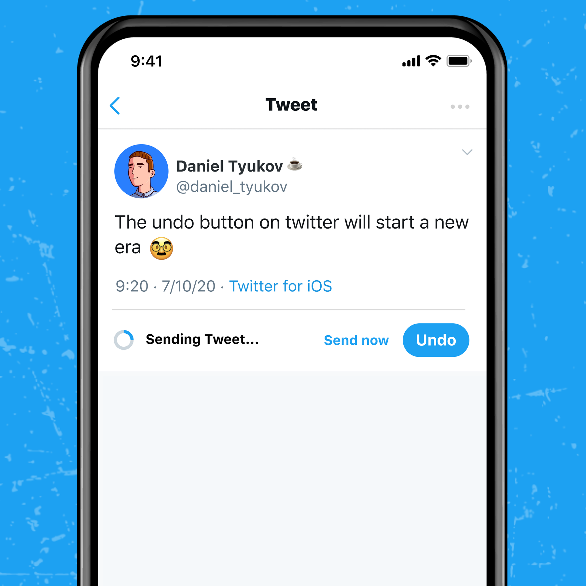
Twitter Activity:
1. Have 1 person in your group write this at the top of your blank paper:
Rigor is ….
2. Pass the paper to your right; fill in your answer
3. Pass the paper to your right; fill in your answer
4. Keep passing until it returns to the original owner
Mrs. Robertson
@Imtheboss
Rigor is …

Slide 5
Douglas Fisher
Global PD Video:
Unstoppable Learning- Rigor
Book:
Unstoppable Learning- Seven Essential Elements to Unleash Student Potential
- Fisher and Frey

Slide 6
Redefine Rigor
1. Take out your Twitter Thread (Rigor is …)
2. On the back AS A GROUP
Redefine What Rigor is ….
Include complexity and difficulty
May want to include examples
3. Be ready to share out your new definition

Slide 7
Douglas Fisher
Global PD Video:
Unstoppable Learning- Rigor
Book:
Unstoppable Learning- Seven Essential Elements to Unleash Student Potential
- Fisher and Frey

Slide 8
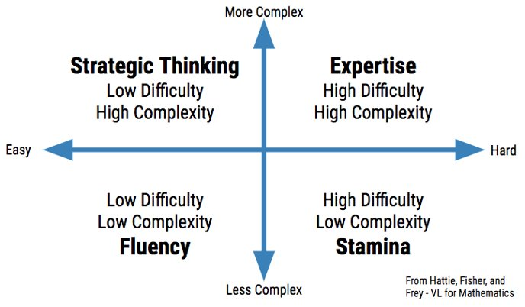

Slide 10
Sorting Activity
As a team sort and determine where the tasks, assignments or activities would go on the quadrant.
2. You will have 10 minutes to work with your group to sort
and place them on the quadrant.
3. Use the Difficulty and Complexity Quadrant to help guide
your discussions about where the tasks, assignments or
activities would fall on the quadrant
**Note you should have strategies in all quadrants

Slide 11
Quadrant Discussion
Take a picture of your team’s finished placement of the tasks, assignments or activities
Compare your group’s quadrants with another group.
Discuss similarities and differences
Justify the placement of the tasks, assignments or activities

Slide 12
Please adjust your quadrant to reflect the collaborative team
Low Difficulty/ High Complexity | High Difficulty/ High Complexity
Jigsaw Method Using manipulatives and tools strategically Reciprocal Teaching | Making connections through real life investigations Peer to Peer feedback on an argumentative essay
Low Difficulty/ Low Complexity | High Difficulty/ Low Complexity
Chunking Collaborating with partners Visuals- Anchor Charts Defining vocabulary Sentence or response frames | Number talks Annotating Multi step problems

Slide 14
THREE PHASES of LEARNING
Surface Learning (low difficulty low complexity; high difficulty low complexity) - foundation for all other learning
Deep Learning (low difficulty high complexity; high difficulty high complexity)- require students to make decisions and problem solve
Transfer Learning (high difficulty high complexity) - require students to use prior knowledge in a new and unique way

Slide 15
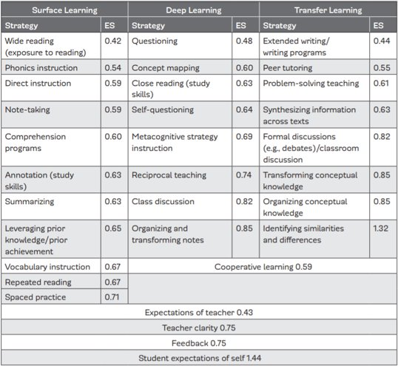

Slide 16
Growing Pains 10/11/20

Slide 17
Let's look at Teacher 1
Case
Study
Teacher 1 Strategies
Jigsaw method
Defining vocabulary
Number talks
Annotating
Chunking
Using manipulatives and tools strategically
Multi Step Problems or tasks
Peer to Peer Feedback on an Argumentative Essay
Collaborating with partners
Reciprocal teaching
Sentence or Response Frames
Making connections through real life investigations
Visuals – Anchor Charts
Guiding Questions:
Look at your data for teacher 1; what connections can you make to the strategies used by teacher 1?
How are the strategies distributed on the chart?
Particularly where did each strategy fall on the quadrant?

Slide 18
Low Difficulty/ High Complexity​ | High Difficulty/ High Complexity​
Jigsaw Method​ Using manipulatives and tools strategically​ Reciprocal Teaching | Making connections through real life investigations​ Peer to Peer feedback on an argumentative essay​ ​
Low Difficulty/ Low Complexity​ | High Difficulty/ Low Complexity​
Chunking​ Collaborating with partners ​ Visuals- Anchor Charts​ Defining vocabulary​ Sentence or response frames​ | Number talks​ Annotating​ Multi step problems​
Teacher 1

Slide 19
Let's look at Teacher 2
Case
Study
Teacher 2 Strategies
Making connections through real life investigations
Peer to Peer Feedback on an Argumentative Essay
Chunking
Collaborating with partners
Visuals – Anchor Charts
Defining vocabulary
Sentence or Response Frames
Task:
On your quadrant take away any strategies Teacher 2 DID NOT use.
Guiding Questions:
Look at your data for teacher 2; what connections can you make to the strategies used?
How are the strategies distributed on the chart?
Particularly where did each strategy fall on the quadrant?

Slide 20
Low Difficulty/ High Complexity​ | High Difficulty/ High Complexity​
 | Making connections through real life investigations​ Peer to Peer feedback on an argumentative essay​ ​
Low Difficulty/ Low Complexity​ | High Difficulty/ Low Complexity​
Chunking​ Collaborating with partners ​ Visuals- Anchor Charts​ Defining vocabulary​ Sentence or response frames​
Teacher 2

Slide 21
Let's look at Teacher 3
Case
Study
Task:
On your quadrant take away any strategies Teacher 3 DID NOT use.
Guiding Questions:
Look at your data for teacher 3; what connections can you make to the strategies used?
How are the strategies distributed on the chart?
Particularly where did each strategy fall on the quadrant?
Teacher 3 Strategies
Making connections through real life investigations
Peer to Peer Feedback on an Argumentative Essay

Slide 22
Low Difficulty/ High Complexity​ | High Difficulty/ High Complexity​
 | Making connections through real life investigations​ Peer to Peer feedback on an argumentative essay​ ​
Low Difficulty/ Low Complexity​ | High Difficulty/ Low Complexity​
Teacher 3

Slide 23
Let's look at Teacher 4
Case
Study
Task:
On your quadrant add or take away any strategies Teacher 4 DID NOT use.
Guiding Questions:
Look at your data for teacher 4; what connections can you make to the strategies used?
How are the strategies distributed on the chart?
Particularly where did each strategy fall on the quadrant?
Teacher 4 Strategies
Chunking
Collaborating with partners
Visuals – Anchor Charts
Defining vocabulary
Sentence or Response Frames

Slide 24
Low Difficulty/ High Complexity​ | High Difficulty/ High Complexity​
 | ​
Low Difficulty/ Low Complexity​ | High Difficulty/ Low Complexity​
Chunking​ Collaborating with partners ​ Visuals- Anchor Charts​ Definig vocabulary​ Sentence or response frames​
Teacher 4

Slide 25
AHAs, Take Away, Next Steps?
How can I use this as an instructional leader?
Do you have teachers always in one quadrant over the other?
What parts do I still need clarity on?

Slide 26
Hattie Effect Size
Jigsaw method – 1.2
Making connections through real life investigations – 0.86
Peer to Peer Feedback on an Argumentative Essay – 0.83 (Seeking Feedback from Peers)
Reciprocal teaching – 0.74
Annotating – 0.5
Cooperative Learning - .40
Using manipulatives and tools strategically – 0.30
What are collaborative teams doing to make the biggest impact?
Are there any strategies, tasks, or assignments that need to be replaced with higher impact ones?
Are we getting the biggest bang out of the time we have students?

Slide 27
Reflection
What conversations are teams having about instructional strategies in Tier 1?
​
What adjustments are teams making in Tier 1 based on these conversations?​
Has your definition of rigor changed?​

Slide 28
Learning Outcomes
I can articulate how rigor is comprised of difficulty and
complexity
I can identify levels of difficulty and complexity within Tier
1 strategies
I can apply this knowledge when embedding into collaborative
teams to help support Tier 1

